Slide 1
Sales Forecasting and Data Analysis using Regression and Correlation in Excel
Submitted By: GROUP 2
Aarav Gupta BTECH/11087/24
Maitreyi Pandey BTECH/11035/24
Aman Agrawal BTECH/11034/24
Pinak Wakhedkar BTECH/11071/24
Parth More BTECH/10658/24
SUBJECT: PE24215
Quantitative Techniques for Data Analysis
BRANCH: PIE
SEM: IV
Submitted to: Dr. Suman Samanta
COLLEGE NAME: BIT MESRA,RANCHI

Slide 2
Agenda
Introduction
Objective of the Study
Dataset Description
Key Analysis
Insights and Recommendations
Conclusion

Slide 3
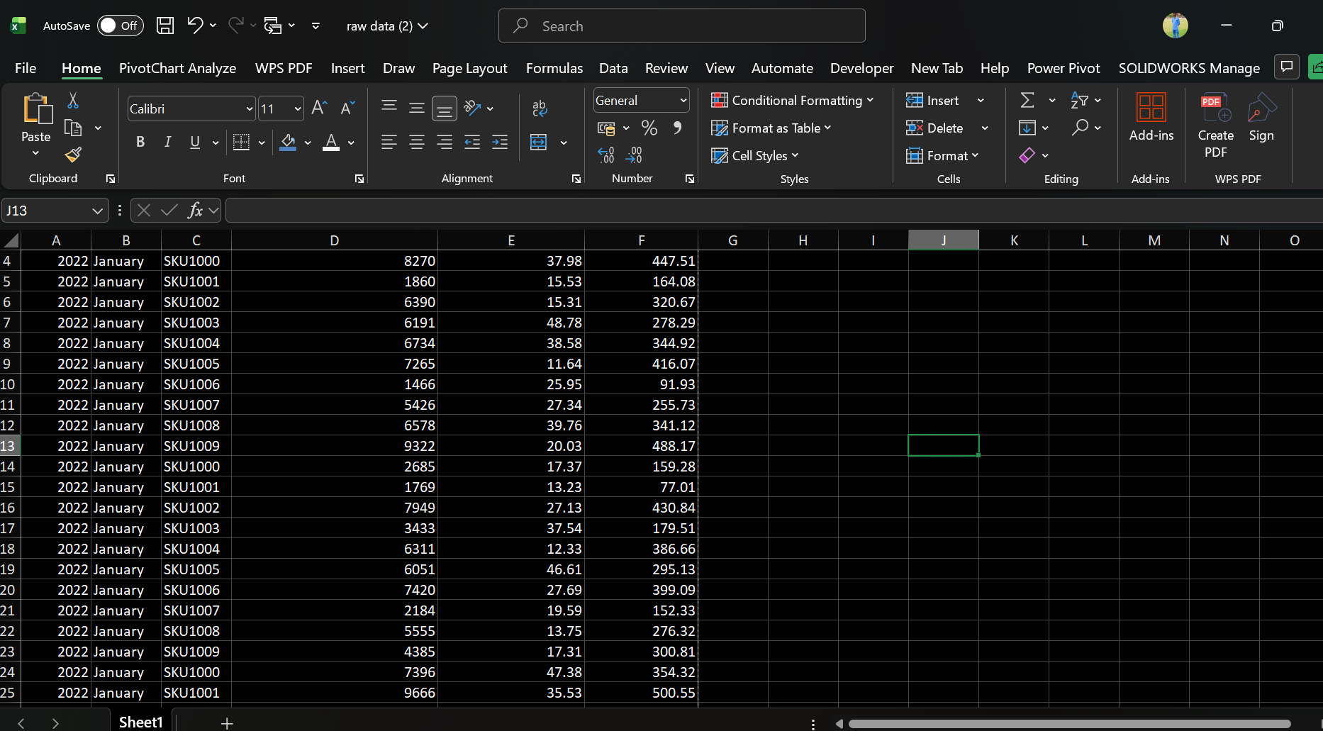
INTRODUCTION
RAW DATASET
Sales forecasting helps organizations predict future demand using historical data and statistical techniques.
This project analyses the relationship between:
Marketing Spend
Product Price
Sales
using:
Correlation
Regression
Trend Analysis
Forecasting techniques in Excel.

Slide 4

Objectives of the Study
Objectives
To clean the dataset using Box & Whisker Plot
To identify outliers in sales data
To measure correlation among variables
To build a regression model
To forecast future sales demand
To provide managerial insights and recommendations

Slide 5
Dataset Description and Problem Statement
Dataset contains:
Year
Month
SKU
Marketing Spend
Product Price
Sales Units
Total Records:
351 observations
Software Used:
Microsoft Excel
Problem Statement
The company wants to analyze historical sales data to:
Identify outliers and clean the dataset
Understand relationship between sales, marketing spend, and price
Develop a regression forecasting model
Predict future sales demand
Support better business decision-making

Slide 6
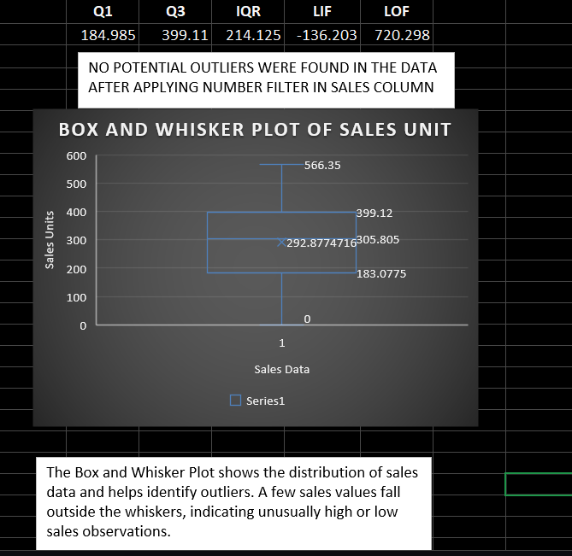
DATA CLEANING USING BOX & WHISKER PLOT
Outlier Detection
Box & Whisker Plot was used to identify extreme values in sales data.
Outliers were detected using:
Quartiles
Interquartile Range (IQR)
Formula:
IQR = Q3 − Q1
Outliers were removed to improve forecasting accuracy.

Slide 7
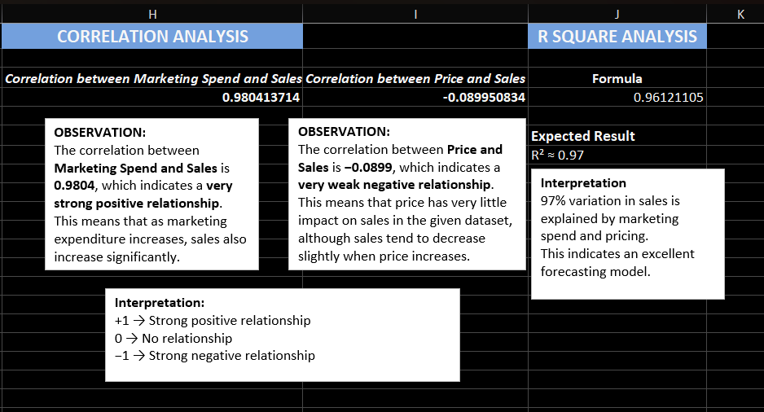
CORRELATION ANALYSIS
Interpretation
Marketing Spend has a very strong positive relationship with sales.
Price has a weak negative relationship with sales.
R Square Analysis
R² ≈ 0.97
This means: 97% variation in sales is explained by marketing spend and price.
The regression model is highly reliable for forecasting.
Correlation Results
Variables | Correlation
Marketing Spend & Sales | 0.9804
Price & Sales | -0.0899

Slide 8
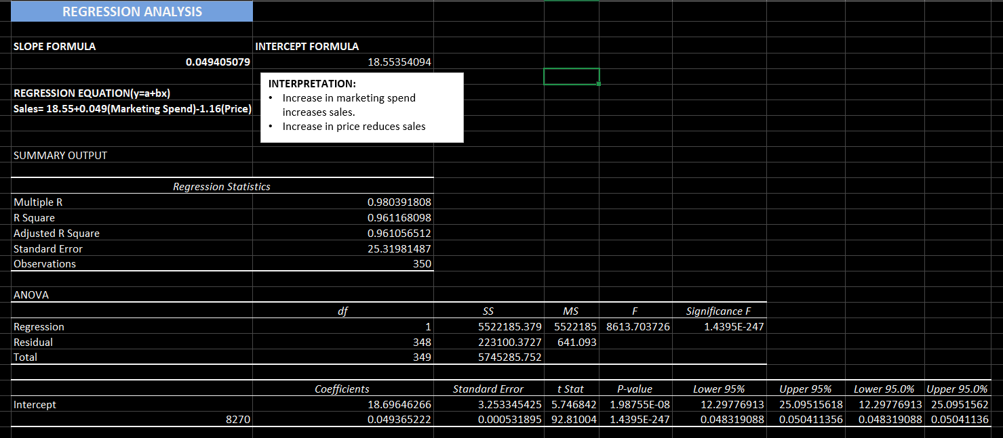

REGRESSION ANALYSIS
Regression Model
Regression equation developed using Excel:
$$Sales=18.55+0.049\left(Marketing Spend\right)−1.16\left(Price\right)$$
Interpretation
Increase in marketing spend increases sales.
Increase in price slightly reduces sales.

Slide 9
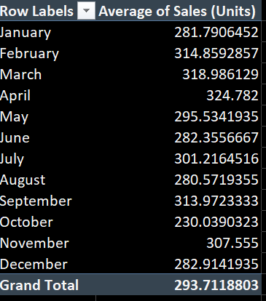
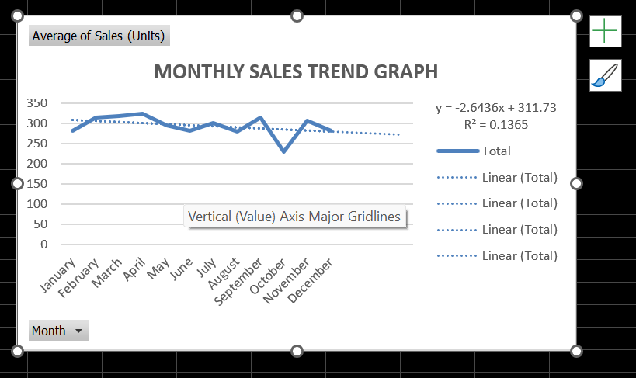
TREND ANALYSIS & FORECASTING
Trend Analysis
A line chart and trendline were used to analyse sales movement over time.
The trendline forecast was extended for:
Next month
Next quarter
Next year
Forecast Observation
“Sales are expected to continue increasing in future periods based on historical trends.”

Slide 10
KEY INSIGHTS & RECOMMENDATIONS
RECOMMENDATIONS:
Increase marketing investments during high-demand periods.
Avoid excessive price increases.
Use forecasting for inventory planning.
Focus on high-performing products/SKUs.
Continue data-driven decision making
Insights
Insight 1
Marketing spend strongly impacts sales growth.
Insight 2
Price changes have relatively lower influence on demand.
Insight 3
Sales show a stable upward trend indicating market growth potential.

Slide 11
CONCLUSION
The project successfully applied quantitative techniques such as:
Correlation
Regression
Forecasting
Trend analysis
The analysis showed that marketing expenditure significantly affects sales and the regression model can be effectively used for future demand prediction.

Slide 12
Thank You!

